Slide 1
Car Price Prediction
Using Regression Models in R
Predictive Analytics Assignment
Name: Shreyansh Kumar Das
Roll No: 752

Slide 2


Project Objective
Goal & Methodology
The primary goal is to predict the selling price of used cars by leveraging predictive modeling techniques.
Predict used car selling price accurately.
Compare standard linear regression against regularized models.
Select the best model using metrics like Adjusted R-squared, R-squared.
Check statistical assumptions and model stability.

Slide 3



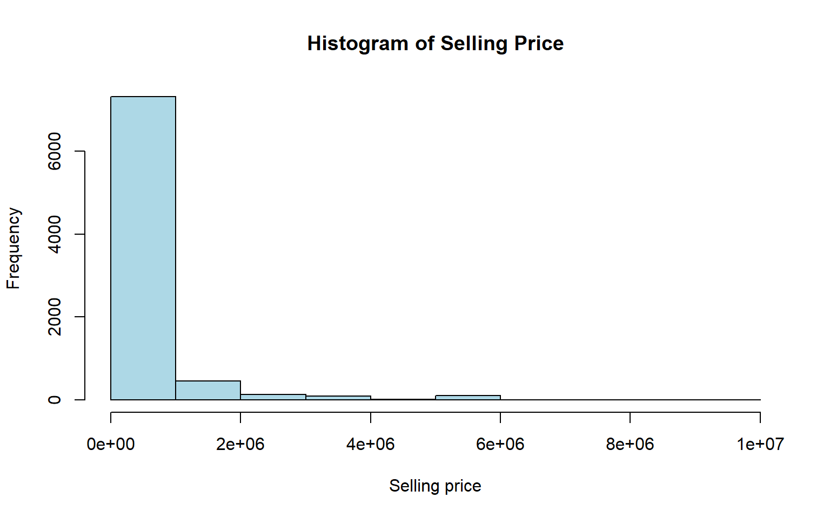
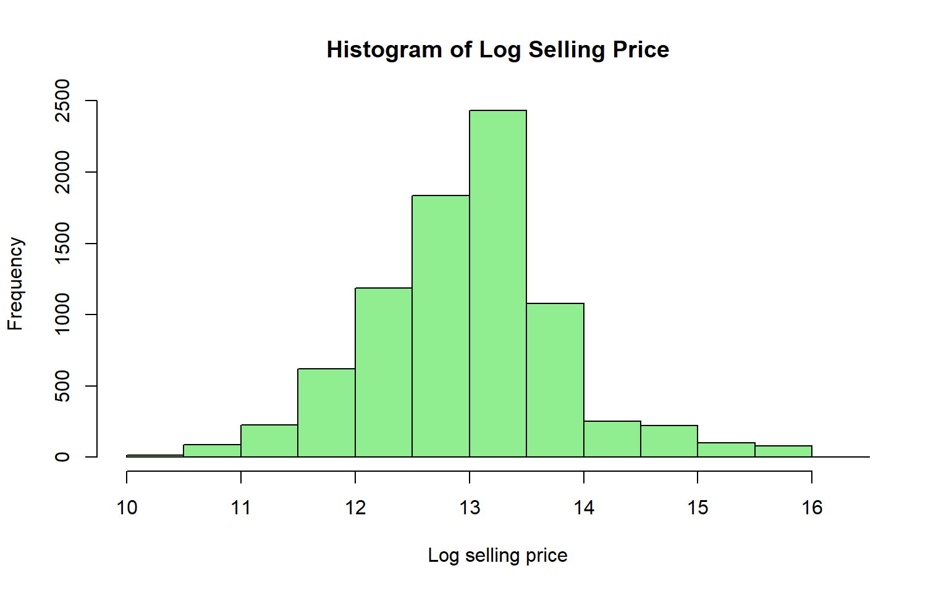
Dataset Description
CarPricing.csv
Target Transformation
The dataset contains historical sales data for various used vehicles. It captures key specifications and market attributes.
Vehicle prices often follow a right-skewed distribution. To satisfy linear regression assumptions, we transformed the target variable.
Target Variable: selling_price
Predictors: year, km_driven, fuel, seller_type, transmission, owner, mileage, engine, max_power, seats, brand.
Dataset Size: The dataset contains 8128 observations and 12 variables.
This conversion normalizes the variance and improves the linear relationships.

Slide 4
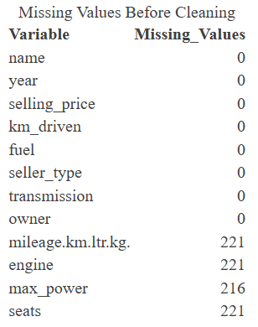
Data Preprocessing
Handling Missing Values: Converted standard numerical columns and replaced missing numeric values (e.g., engine, seats) using the column median to avoid dropping critical rows.
Categorical Factors: Converted text-based variables (fuel, transmission) into mathematical factors. Extracted 'brand' from the full car name and grouped rare brands as "Other".
Feature Engineering: Created new predictive variables such as car_age from the manufacture year, and log_km_driven to reduce the extreme variance in distance driven.

Slide 5
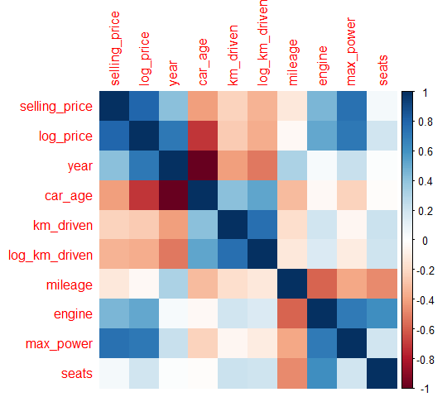
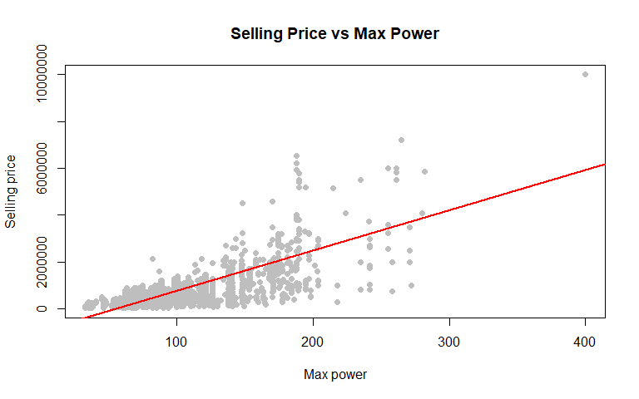
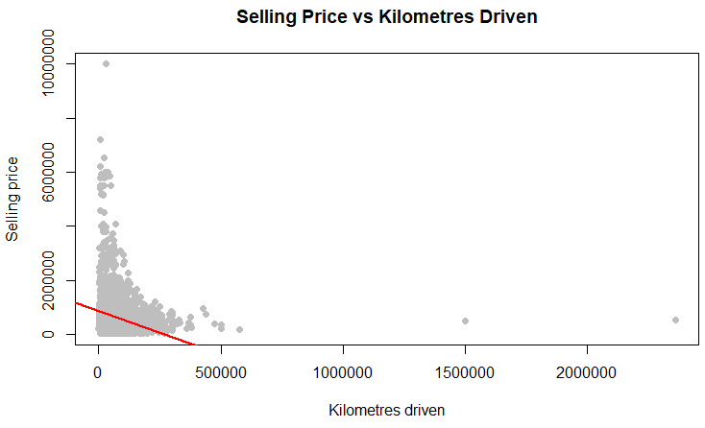
Exploratory Data Analysis
Key Correlations
Max Power: Displayed the strongest positive linear relationship with selling price.
Car Age & Usage: Both car_age and km_driven showed an expected negative relationship with price.
Transformation Impact: The log transformation of price successfully addressed skewness, making the distribution bell-shaped and suitable for regression modeling.

Slide 6
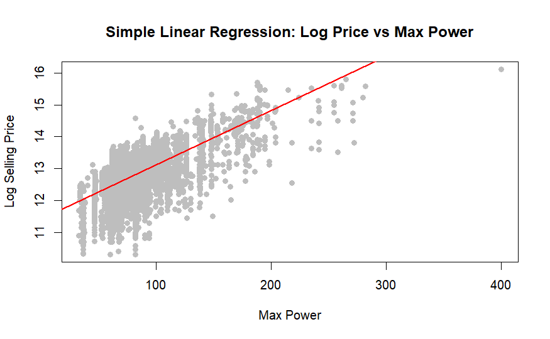
Simple Linear Regression
Establishing a Baseline
We built a simple model using the single most correlated predictor.
log(selling_price) = β₀ + β₁(max_power) + ε
Selection: max_power was chosen due to its dominant positive correlation.
Significance: The predictor was statistically significant (p < 0.05).
Limitation: While highly interpretable, a single variable has limited predictive power for complex pricing.

Slide 7
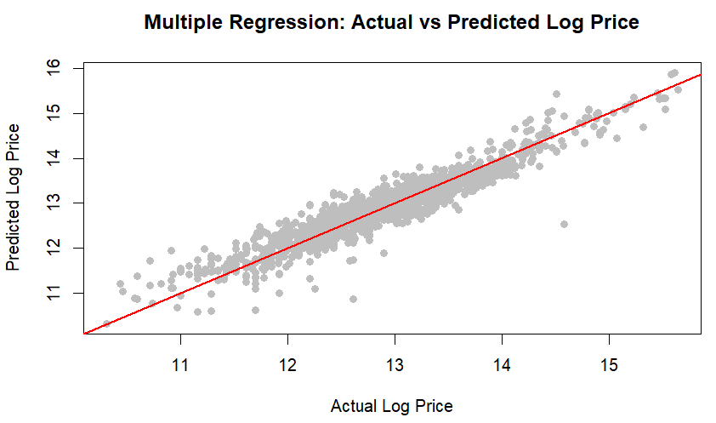
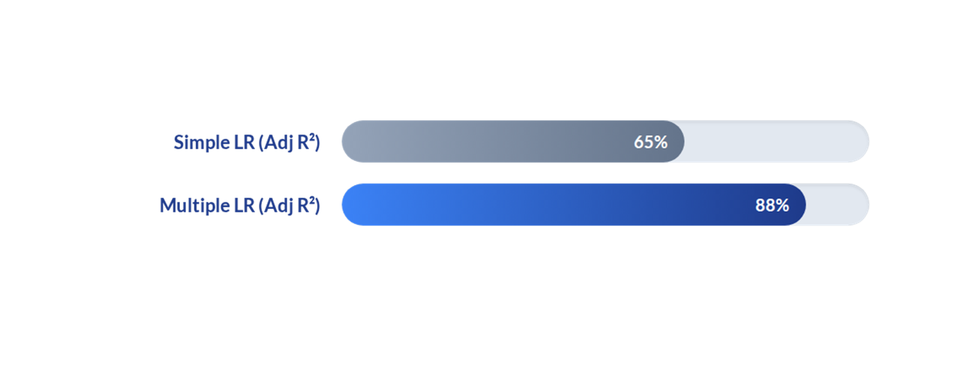
Multiple Linear Regression
We built a multiple linear regression model using several numeric and categorical variables.
log(selling_price) = β₀ + β₁(car_age) + β₂(log_km_driven) + β₃(fuel)
+ β₄(seller_type) + β₅(transmission) + β₆(owner)
+ β₇(mileage) + β₈(engine) + β₉(max_power)
+ β₁₀(seats) + β₁₁(brand) + ε
Improvement: Multiple Regression gives a much higher R-squared and Adjusted R-squared than Simple Regression.
Interpretability: The model is easy to interpret because each coefficient shows the effect of one predictor while holding other variables constant.
Conclusion: Multiple Regression performed better than SLR based on Adjusted R-squared.

Slide 8






Diagnostic Analysis
Outliers
Multicollinearity
Residuals
There are 69 residual outliers, 663 high leverage points, and 328 influential points using the selected rules. .
Variance Inflation Factor (VIF) was utilized to detect multicollinearity between predictors like engine size and max power.
Residual plots were examined. The Shapiro-Wilk test checked for normality, while the NCV test evaluated constant variance.

Slide 9

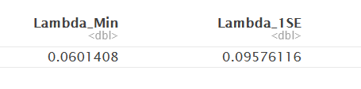
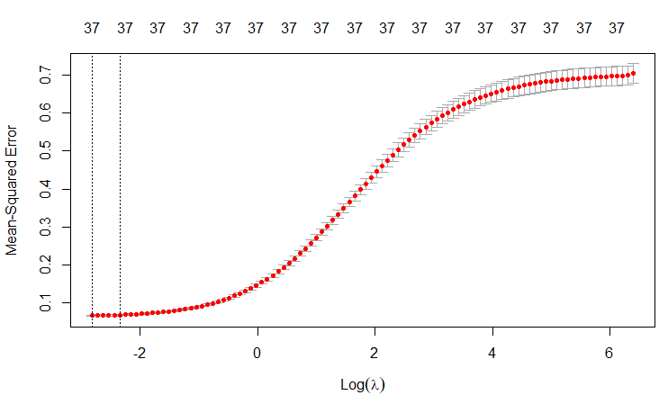
Ridge Regression
We built a ridge regression model to handle correlated predictors and reduce coefficient instability.
log(selling_price) = β₀ + β₁(car_age) + β₂(log_km_driven) + ... + βpXp + ε
with Ridge penalty: λΣβj²
Regularization: It shrinks large coefficients toward zero, making the model more stable.
Limitation: Ridge does not remove variables completely; it keeps all predictors in the model.
Conclusion: Ridge performed well, but Multiple Regression had a slightly higher Adjusted R-squared in this dataset.

Slide 10

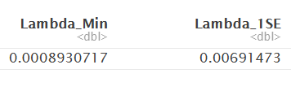
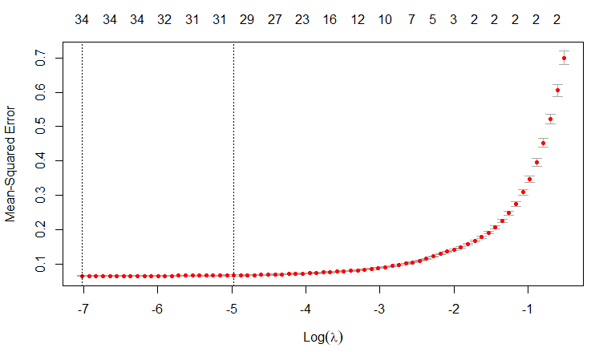
LASSO Regression
We built a LASSO Regression model to perform feature selection and improve model simplicity.
log(selling_price) = β₀ + β₁(car_age) + β₂(log_km_driven) + ... + βpXp + ε
with LASSO penalty: λΣβj²
Regularization: It shrinks some coefficients exactly to zero.
Feature Selection: Variables with zero coefficients are removed from the model.
Lambda Selection: Cross validation was used to choose the best lambda value.
Conclusion: LASSO performed very close to Multiple Regression but did not give the highest Adjusted R-squared.

Slide 11

Elastic Net Regression
We built a LASSO Regression model to perform feature selection and improve model simplicity.
log(selling_price) = β₀ + β₁(car_age) + β₂(log_km_driven) + ... + βpXp + ε
with Elastic net penalty: λ[(1 - α)Σβj² + αΣ|βj|]
Combination: It combines Ridge Regression and LASSO Regression in one model.
Alpha Value: When α is close to 0, Elastic Net behaves more like Ridge; when α is close to 1, it behaves more like LASSO.
Lambda Selection: Cross validation was used to choose the best lambda value.
Conclusion: Elastic Net performed very close to LASSO and Ridge, but Multiple Regression still had the highest Adjusted R-squared.

Slide 12









Feature Selection Methods
Selection Algorithms
Optimal Predictors Selected
We applied three algorithms to identify the optimal subset of predictors to prevent model overfitting:
Models were evaluated using BIC, Mallows' Cp, and Adj R². The optimal Best Subset isolated the following key predictors:
Best Subset Selection: Evaluates all possible combinations of predictors to find the absolute best fit.
Forward Stepwise: Starts with an empty model and sequentially adds the most impactful predictors.
Backward Stepwise: Starts with a full model and removes the least significant predictors one-by-one.

Slide 13
Model Selection & Performance
Model Type | R-Squared | Adjusted R-Squared
Simple Linear Regression | 0.652 | 0.652
Ridge Regression | 0.865 | 0.858
LASSO Regression | 0.871 | 0.864
Elastic Net | 0.868 | 0.862
Multiple Regression (Best Subset) | 0.884 | 0.879
Best subset selection was performed using Adjusted R², BIC, and Cp criteria.

Slide 14
Model Validation
Testing Model Stability
5
To ensure our models were not overfitting the training data, we deployed k-fold cross-validation.
The dataset was randomly partitioned into 5 equal folds.
Models were evaluated based on their Average R-squared and RMSE across all iterations.
Fold Cross-Validation
The cross-validation framework overwhelmingly supported Multiple Regression as the most stable and accurate model.

Slide 15
Final Conclusion
Multiple Linear Regression was selected as the best-performing model based on its superior predictive performance and cross-validation stability.
Role of Regularization: While Ridge, LASSO, and Elastic Net were highly useful for addressing multicollinearity and providing baselines, OLS Multiple Regression maintained edge in accuracy.
Key Market Drivers: The analysis confirmed that a vehicle's age, kilometres driven, max power, engine size, transmission type, and brand are the most critical factors dictating resale price.

